Slide 1
Introduction and Basics
Module 1

Slide 2
Intro

Slide 3
What is HTML?
HTML: Hyper Text Markup Language
Markup Language: A standardized way to describe and represent information
There are many markup languages, like XML, YAML, or Markdown, but HTML is for displaying information on a Website

Slide 4
What is HTML?
HTML Docs are a series of elements, which are different types of “building blocks” of doc
Elements tell the browser how to display the content we give them
Elements label pieces of contents as headings, paragraphs, images, and more

Slide 5
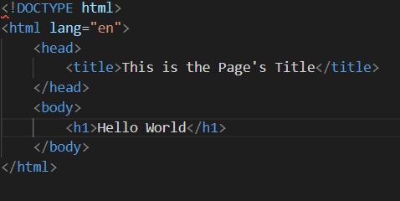
HTML Document Example

Slide 6

HTML Document Example

Slide 7
HTML Document Example
<!DOCTYPE html> defines that this is an HTML5 Document
<html> is the root element of the HTML Document
<head> contains meta information about the doc

Slide 8
HTML Document Example
<title> specifies the title of the page, which is shown on the tab of the browser
<body> defines the doc’s body, which holds all visible elements
<h1> defines a large heading

Slide 9

What is an HTML Element?
HTML Elements generally have a start tag, followed by some text, followed by an end tag
The Element is everything from the start tag to the end tag
Note: Not all elements will follow this scheme, but it is the rule of thumb that they do

Slide 10
Web Browsers
Browsers are used to read and display HTML docs (along with their CSS and JS files)
The tags of an element are never displayed, only used to tell how to display the content

Slide 11
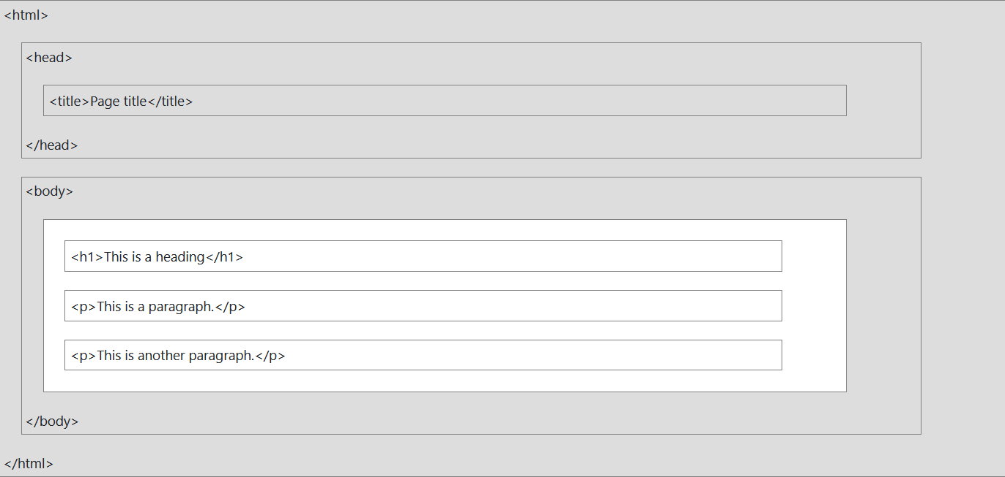
HTML Page Structure

Slide 12
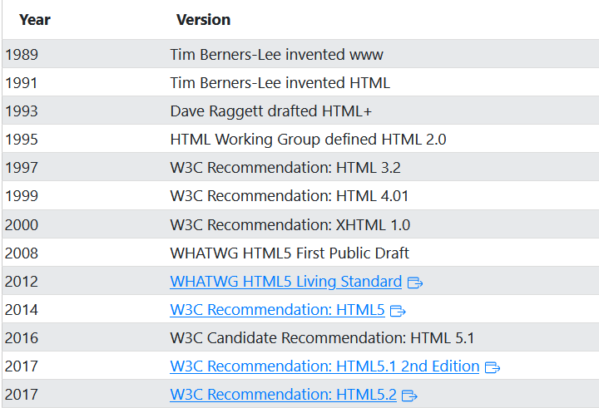
History of HTML

Slide 13
HTML Editors

Slide 14

Code Editors
There are all different types of editors that you can use to write HTML in ranging from Notepad (native to windows) to more specialized options like IntelliJ
In this class we’ll be using Visual Studio Code (VS Code) since that is the Tech industry’s most used IDE

Slide 15
HTML Basic Examples

Slide 16
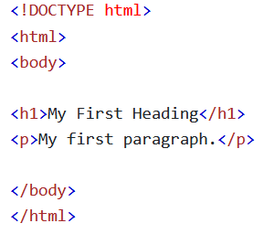
HTML Documents
All HTML docs must start with the <!DOCTYPE html> for browsers to know we are using HTML
The HTML document itself begins and ends with <html> and </html>
The part of the document that we display to users is body, which is between <body> and </body>

Slide 17

Headings
Headings are creating using <h1> - <h6> tags
The most important tags have lower numbers and display larger while the least important tags are higher and display smaller
You should only use one of each type of heading in a doc

Slide 18

Paragraphs
Paragraphs are created using the <p> tag

Slide 19
Links
You can create links using the <a> tag (commonly called an achor)
The link’s destination href attribute is the url the link will take you to
The text between the start and end tag is what will display on the web page

Slide 20
HTML Images
You can add images to your web page using the <img> tag
<img> elements have src, alt, width, and height attributes you must give values to
Note: <img> elements have no end tag

Slide 21
How to View HTML Source Code
Sometimes you might want to replicate the code of another web site to use on your pages
You can right click on any web page and select the “inspect” or “view page source” option
You can also (depending on your browser) press either f12, fn + f12, or fn + shift + f12 to open the dev tools to gain access to source code

Slide 22
Elements

Slide 23
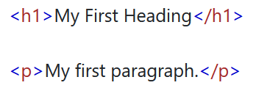
Elements
Again, an Element is everything from the start tag to the end tag
Examples:
<h1> - Heading
<p> - Paragraph
<br> - Line break

Slide 24
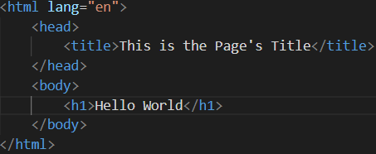
Nested Elements
Some elements can nest other elements, meaning they can have other elements inside of them
All HTML documents use these - every other element is found inside of the <html> element
You generally indent/double space after each element to create a “nesting” effect

Slide 25
Never Skip the End Tag
Some elements will still display correctly if you forget the end tag
This is because your IDE/editor will “fix” it for you, but this is unreliable
Form good habits and always complete your elements

Slide 26

Empty Elements
Not all elements contain content
The <br> tag defines a line break and is an empty element without a closing tag

Slide 27
Not Case Sensitive
Tags are not case-sensitive, but you should write your tags in lowercase anyways
Some other document types like XHTML require lowercase
Frameworks like React.js use some upper case so be sure to write in lower case
Notes:
This does not include <!DOCTYPE html>

Slide 28
Attributes

Slide 29
Attributes
All elements can have attributes
Attributes give extra information about elements
Attributes are specified in the start tag, like the href attribute of an anchor (<a> element

Slide 30
Attributes
Generally come in name/value pairs like name=“value”

Slide 31
The href Attribute
The <a> tag defines a link
The href attribute tells the anchor which url the link will go to

Slide 32

The src Attribute
We use <img> tags to embed an image in an HTML page
The src attribute specifies the path to the image to display
There are two types of file paths

Slide 33
File Paths
Absolute Path:
An entire link like: src=https://www.w3schools.com/images/img_girl.jpg
Relative Path:
The path from the file to another file in a folder like: src="/images/img_girl.jpg"
This is much more reliable since it will never change

Slide 34
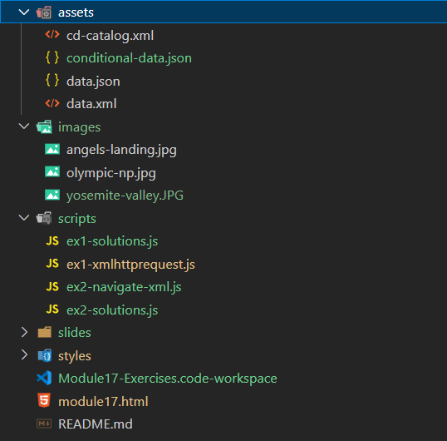
Relative Paths
Any time you go down a file you put a / and then then the name of the file or folder that you file is in
Any time you need to go up a folder you put two dots (..)

Slide 35
Relative Paths
Let’s try it!
What would the path be from the root directory (top folder) to README.md be?
Notes:
Solution: README.md

Slide 36
Relative Paths
Let’s try it!
What would the path from module17.html to data.json be?
Notes:
Solution: assets/data.json

Slide 37
Relative Paths
Let’s try it!
What would the relative path from ex1-solutions.js to angels-landing.jpg be?
Notes:
Solution: ../images/angels-landing.jpg

Slide 38
The width and height Attributes
<img> tags always have both a width and a height measured in pixels
Both of these attributes are required

Slide 39
The alt Attribute
<img> elements require an alt attribute that describes whatever the image is
The text will appear on screen if the image cannot load for whatever reason
This often happens due to laggy internet or if users have a screen reader for accessibility

Slide 40
The style Attribute
We can use the style attribute of add CSS styling to any element, such as color, background color, padding, margins, and more
The value of this attribute is code written in CSS
This is not actually how we style our HTML pages, but we do have the option to occasionally style something in this manner

Slide 41
The lang Attribute
The lang attribute is specific to the <html> element and tells the browser which language the page is in
The lang attribute supports country codes as well
This attribute assists with search engines

Slide 42
The title Attribute
The title attribute defines extra info about an element
Any time you hold your mouse over an element it will display the value of the title

Slide 43
Always Use Lower Case Attributes
You are not required to use lowercase attribute names, but it is a best practice to stick to lower case
Other document types require lower case (like XHTML), so it’s a good idea to use it for compatibility
Additonally, JavaScript frameworks like React.js use upper case letters on HTML attributes

Slide 44
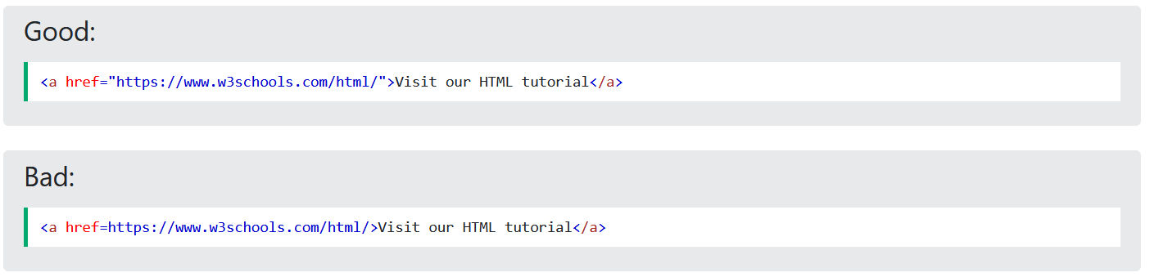
Always Quote Attribute Values
You aren’t required to put quotes around your attribute values either, but it will cause problems for you down the road
In JavaScript we will frequently need to select these attributes, so they must be in the proper format to avoid errors

Slide 45

Single or Double Quotes?
Some languages require you to chose a specific type of quotes, but HTML will allow you to use either ‘single’ or “double quotes”
However, if you ever need to put quotes inside of an attribute value, you must use the opposite set of quotes

Slide 46
Questions?

Slide 47
Practice
Try out 1.5 HTML Attributes – Exercises on W3Schools
Module1-Exercises

